Slide 1

Intelligent Video Surveillance System for Improving Safety and Security
SUBMITTED TO:
Prof. Otman A.Basir
SUBMITTED BY:
Jubilee Imhanzenobe (20809735)
Harnoor Singh (20870613)
Ishpinder Kaur (20911296)

Slide 2
Need of the hour
In this advanced era, everything task can be accomplished through digital means and internet. Due, to online streaming of huge amount of data added every second into and advancement in technologies like signal processing and artificial intelligence, machines have become intelligent enough and efficient to achieve level of sophistication where human eye can give an error. The evolution of technology, not only provides fast computational results, but can also be used for security and safety purposes, by installing an Intelligent Video Surveillance system .

Slide 3
What is IVS?
Video surveillance systems like CCTV cameras are extensively deployed in a variety of sectors, including health sectors, traffic control, oil and gas mining, commercial buildings and more public areas.
These information sources collect the real time information from the deployed devices and analyze it for detecting any abnormal activity.
Past data helps in future decision making by mining insights.
Present data discovers motion patterns and can identify it.

Slide 4
Why is it required?
Various incidents or crimes can be prevented analyzing data especially, captured through the images and videos, as, human observation of these activities is a difficult, time consuming, error prone and not always efficient.
For security and safety: The data recordings act as strong evidences and display the details of any crime or rule breaking happening in that area and helps in recognizing where and what type of preventive measure should be taken to avoid that.
To prevent road incidents: By detecting over-speeding, breaking of traffic rules and then, identifying the vehicle owner to take appropriate actions.
To capture the motions of activities where human presence cannot be possible or dangerous such as war zones, military areas, nuclear plants, coal mining fields, etc.
Violent social gatherings can be prevented. Also, in case of peaceful protests, the safety of common people can be ensured.
Global Awareness

Slide 5
Some of the Current examples of their application on global level are:
In 2021, forest fire in Turkey is detected through the deployed intelligent systems and its cause is analyzed by recordings, as no human can place foot in such circumstances.
In 2020, the violence and its cause is identified in the beginning of Farmer protest, which is still going on in India, so, these information sources ensures that how people were actually treated and how they need safety and support.
In 2020, the brutal treatment of George Floyd by police is detected and new wave of equality and justice began.
Various natural disasters likes landslides, Tsunamis were happening around the world, so, the recorded and broadcasted information spreads awareness about the current situation to the people and government for taking preventive measures.
Apart from this it also ensures the women safety and prevents rapes by detecting any abnormal behavior around her captured through the CCTV.
Social Distancing: These systems also came in handy to keep a control and discipline during the COVID lockdown situation.

Slide 6
Implemented Intelligent Surveillance System
Video analytics is achieved by combination of various machine learning and signal processing techniques. In our case, the ‘Virat Video Dataset’ has been used for detecting and analyzing the recorded footages, which includes human actions, objects and human vehicle interactions. The deliverables of implementation and methods involved are:
Motion Detection
Face Recognition
Object Detection

Slide 7
Motion Detection
Video Motion Detection (VMD) was introduced in the early 1990s, which detects any change in the position or movement of object or person with respect to its surroundings or vice versa.
Common Motion Detection techniques:
Background Subtraction
Temporal Difference
Pixel based Algorithms
Gaussian Mixture Modeling (GMM)

Slide 8
Object Detection
Few Traditional Object Detection techniques are:
Viola Jones Detectors (2001)
HOG Detector (2005)
Deformable Part-based Model (2008)

Slide 9
Object Detection
Deep Learning based Object Detection techniques include:
1) CNN based two stage detectors:
a) RCNN
b) SPPNet
c) Fast RCNN
d) Faster RCNN
e) FPN
2) CNN based one stage detectors:
a) YOLO
b) SSD
c) RetinaNet

Slide 10
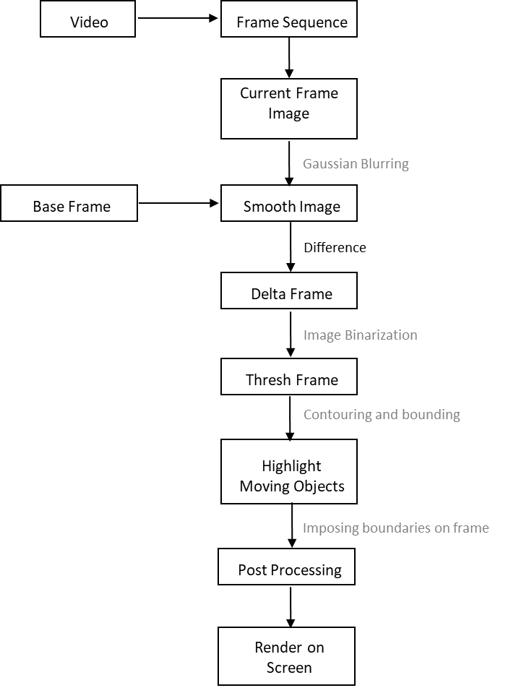
Motion Detection
Background subtraction technique is deployed where moving objects are detected by calculating the difference between the current frame and the base frame or a reference frame. Following steps are then followed:
Figure 1: Block diagram of the Background
Subtraction motion detection model

Slide 11
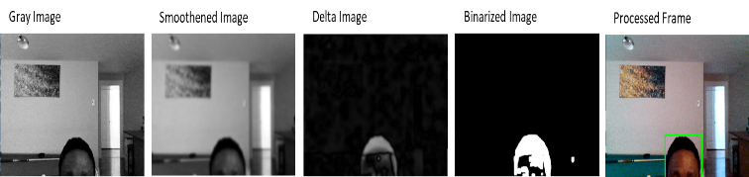
The frame is converted to gray scale and then Gaussian Blur is applied to the gray image by passing it through a Low Pass Filter to smoothen it and noise is removed. Then, the current frame and the base frame difference is calculated.
Image binarization is then applied to the Delta frame, to produce a binary image with only pure white or pure black pixels.
The binarization of the frame can figure out the contours. The contours with very small area are filtered out and the resulting ones are bounded by rectangles which are imposed on the frame and then displayed.
Figure 2: Output after the different stages of the Background Subtraction

Slide 12
Face Recognition
This technology can identify human face by measuring various facial features and matching it with the saved data in database, for authentication purposes. The data sources are photos or videos gathered from surveillance systems, commercial/private cameras, CCTV, or other commonplace hardware. The four subclasses of face recognition methods:
Holistic Methods
Local (geometrical) Methods
Local Texture descriptors-based Methods
Deep Learning-based Methods.
- Unsupervised or generative (Auto encoder, RNN)
- Supervised or discriminative (CNN)
- Hybrid Deep Neural Network (DNN)

Slide 13
Face Recognition
Face recognition involves 2 steps which are as follows :
Face Detection: It entails the detection of a face in the frame.
Classification: It is the conventional supervised machine learning problem that labels a detected face with the proper identity using the extracted features.

Slide 14
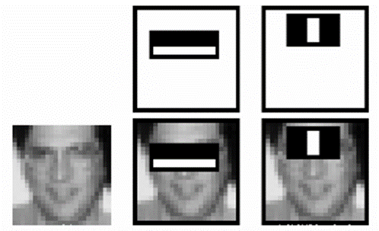
Face Detection
a) Face Detection with Haarcascades:
It is a machine learning method introduced in 2001, for detecting faces where a cascade function is trained from a lot of positive (images with faces) and negative images (images without faces). The facial features are then extracted using Haar features. Each feature is a difference between sum of pixels under the white rectangle and the black rectangle.
Figure 3: Applying the Haar features on
the image

Slide 15
Face Detection
b) Face Detection with MTCNN
The Multi-Task Cascaded Convolutional Neural Network has a unique structure that cascades three network structures. Following is the working of this network -
The image is first rescaled into hierarchical sizes to form the image pyramid.
The first model Proposal Network (P-Net) proposes candidate facial regions using a shallow CNN, then the second model Refine Network (R-Net), filters the bounding boxes using a more complex CNN, and the final model Output network (O-Net) proposes the facial landmarks.
The three sub-models are trained on three different tasks which are face classification, bounding box regression and landmark localization and outputs of previous models are fed as inputs to subsequent models thus forming a three-network chain.

Slide 16
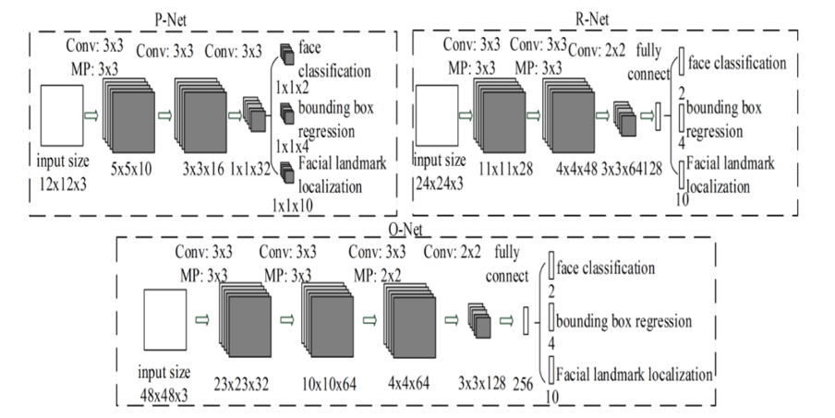
Face Detection
Figure 4: Model diagram of the MTCNN network

Slide 17
Classification
Once vectors are achieved from facial detection, they are fed to classification models for the actual labelling of the face.
In this implementation, the performance of three different classification models were compared.
1) Logistic Regression: A machine learning classification that uses a sigmoid function to bound the output of a linear equation to a non-linear curve in the range of 0 and 1. This model updates the weight parameters during training, where cost function and gradient descent calculation is repeated multiple times and the weights are updated with each iteration to find the optimal solution.
2) Kernel Support Vector Machine: SVM ML method separates the different target classes using a hyper-plane in n-dimensional, in order to create the best decision boundary and thus, correctly classify the new data points.

Slide 18
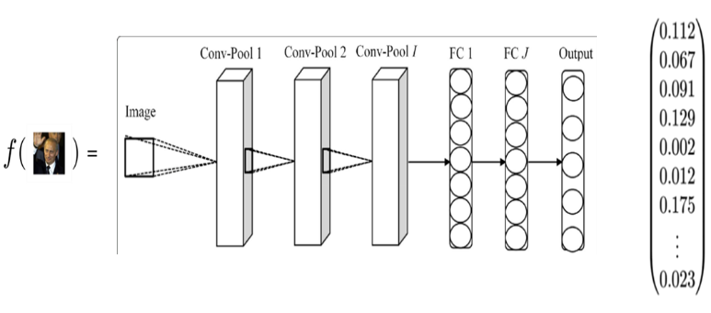
3) Neural Network: It performs a feature extraction operation on the detected face and then find Euclidean distance between extracted features., to compare them. Thus, it can be observed that the facial embeddings of the same face are close and, that of different faces are far in the vector space. Also, a threshold is set to classify between similar and dissimilar faces. In this case, a threshold of 0.6 was set so that if the distance between any two face embeddings exceeds the threshold, then the model classifies them as different, else same.
Figure 5: The network diagram of the neural network showing the feature extraction

Slide 19
Object Detection
Objects are recognized, identified, and located within a picture, provided a given degree of confidence. In our implementation, performance of two different models is compared, namely -
Resnet50
YOLO

Slide 20
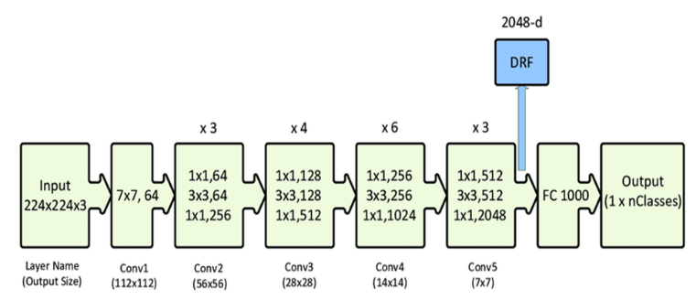
Object Detection – ResNet:
1)ResNet: A residual neural network (ResNet) are implemented with double or triple layer skip connections that contain nonlinearities (ReLU) and batch normalization in between. It provides smooth flow of data without effecting its learning ability. The skip connections prevents accuracy saturation, vanishing or exploding gradient problem, and thus, boosts the training speed.
Figure 6: Model diagram of the ResNet50 Convolutional Neural Network

Slide 21
ResNet Architecture:
The implementation architecture details are as follows :
The first layer is a convolution layer with a kernel size of 7 and 64 different kernels all with a stride of size 2. Next layer is a max pooling layer with a stride size of 2. The next convolution process on the pooled image uses 64 kernels of size 1 x 1. Following this, a 3 x 3 x 64 kernel convolution is implemented . After this , a 1 x 1 x 256 kernel convolution. These three layers are repeated 3 times giving a total of 9 convolution layers in this step.
The next step is another convolution step with 1 x 1 x 128 kernel. After that, a kernel of 3 x 3 x 128 and at lastly a kernel of 1 x 1 x 512 this step was repeated 4 times making a total of 12 convolution layers in this step.
The next convolution phase uses a kernel of 1 x 1 x 256 and two more kernels of 3 x 3 x 256 and 1 x 1 x 1024 and this is repeated 6 times making a total of convolution 18 layers.
The last convolution phase uses a 1 x 1 x 512 kernel with two more kernels of 3 x 3 x 512 and 1 x 1 x 2048. The setup is repeated 3 times making a total of 9 convolution layers in this phase.
Finally, the resulting image is average pooled and flattened. The classification is done with a fully connected layer containing 1000 nodes using the SoftMax activation function.

Slide 22
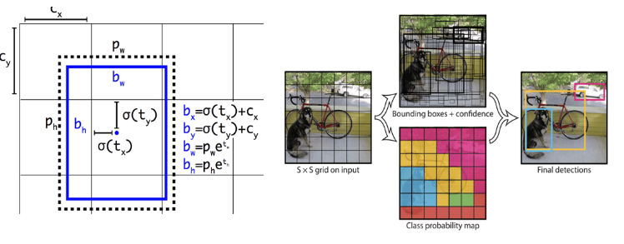
Object Detection - YOLO
YOLO (You Only Look Once): This model splits the input image into a grid where each grid cell predicts a bounding box and a confidence value. The bounding box is represented by a centroid (x, y coordinates), the width and height. The overall class prediction depends upon the prediction of individual cells.
Figure 7: Bounding boxes with dimension priors and location prediction.
The width and height are predicted as offsets from the cluster centroid.

Slide 23
Object Detection - YOLO
The YOLOv3 is Darknet-53 based network architecture and has a total of 53 convolution layers which are all followed by a batch normalization layer and Leaky ReLU activation, without any pooling layers , to prevent the loss of low-level featured that may arise during down sampling.

Slide 24
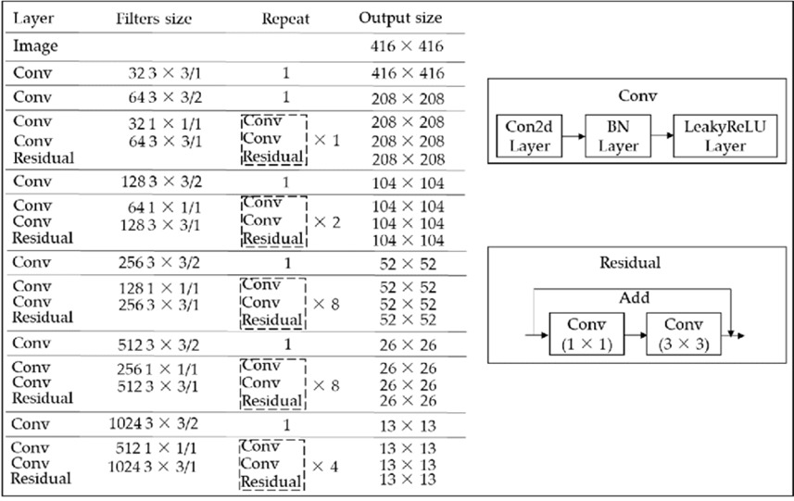
Object Detection - YOLO
Figure 8: Network configuration of the YOLOv3 model

Slide 25
Research Questions and Hypothesis
Q1. How effective is the background subtraction technique of motion detection under varying environmental conditions?
Q2. Which method is more suitable for face detection between Haar-cascades and MTCNN?
Q3. Which of the classification methods between CNN, Logistic Regression and Kernel SVM is most suitable for recognizing faces in application to IVS?
Q4. Which of the object detection models between ResNet and YOLO is more suitable for IVS application?

Slide 26
Q1. How effective is the background subtraction technique of motion detection under varying environmental conditions?
- To answer the first research question, the background subtraction algorithm developed in this work will be tested with real time surveillance under varying environmental conditions. The environmental conditions that would be varied our lights and wind the performance of the glory team will be estimated by visual inspection.

Slide 27
Q2. Which method is more suitable for face detection between Haar-cascades and MTCNN?
- For this, the two different face detection techniques will be tested with four different images with a total of 100 faces. The faces are well varied with some tilted some giving gestures some wearing glasses, and some even slightly covered. The accuracy of the detection technique will be measured by the number of faces each method is able to detect from the datasets.

Slide 28
Q3. Which of the classification methods between CNN, Logistic Regression and Kernel SVM is most suitable for recognizing faces in application to IVS?
- For the third question, the famous Labeled Faces in the Wild (LFW) dataset of face photographs will be used. This dataset was designed for studying the problem of unconstrained face recognition and it consists of 13,233 images and 5759 identities. This database was created and maintained by researchers at the University of Massachusetts, Amherst. In this experiment will be computing the accuracy of the different classification models under varying training sizes. Considering that the aim of this work is for implementation of IVS in real time video surveillance we will also be comparing the time performance off the different methods.

Slide 29
Q4. Which of the object detection models between ResNet and YOLO is more suitable for IVS application?
- For the last research question, the Virat Video Dataset taken from CCTV security footages which includes actions performed by the general population at different locations will be used to compare the time and detection performance of the different object detection models. A set of random images collected over the internet will also be used to compare the detection performance of the three models.

Slide 30
Results and Comparisons:

Slide 31
Comparison of Face Detection Techniques:
Haarcascades:
The Haarcascades technique had a detection accuracy of 72 percent. A closer inspection of some of the input images and the output of the detection algorithms showed that Haarcascades could not effectively identify distorted faces. Also, it could not identify faces with covered eyes or tilted heads effectively and thus, more prone to false positives as it falsely detected some non-faces as faces.
In terms of computation, the Haar classifier was more computationally efficient and took less execution time (average of 4.3 seconds for the image dataset)
MTCNN:
MTCNN showed a higher degree of freedom and could detect partially covered faces and tilted faces with 87 percent detection accuracy.
MTCNN took more execution time with an average of 8.1 seconds.

Slide 32

Figure 9: Comparison of the outputs of Haarcascade face detector (left column)
and MTCNN face detector (right column)

Slide 33
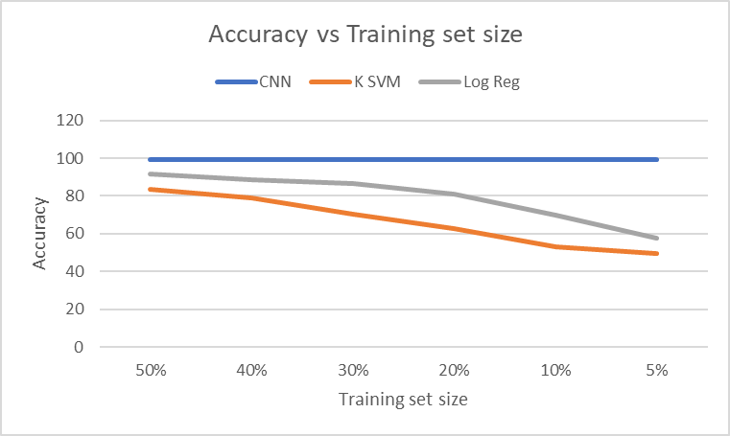
Comparison of Face Classification Techniques
For comparison , experiments were carried out using the LFW dataset with varying training size. The training set was varied through 50%, 40%, 30%, 20%, 10%, and 5% of the dataset. The predicted results of the three models were computed and is shown below:
.
Figure 10: Accuracy of the CNN, Kernel SVM and Logistic regression classification models

Slide 34
Comparison of Face Classification Techniques:
Model | Average Training time | Average testing time
CNN | 1420ms | 49800ms
Kernel SVM | 979ms | 1200ms
Logistic Regression | 1610ms | 36.9ms
Table 1: Table showing the computational time
for training and testing the classification models
Accuracy: From the plot, the accuracy of Kernel SVM and Logistic regression decreased as the training size decreased. The accuracy of the Deep network on the other hand remained the same. This can be attributed to the fact that it is able to extract important features from the face (face embeddings) which is then used to in calculating similarity or dissimilarity between faces.
Time efficiency: In terms of computation time, the training time and test time for the different models was measured . The result shows that for its high accuracy, CNN has a computational trade-off as it has a high execution time in testing. Logistic regression had the least testing execution time. In training, Kernel SVM had the best time efficiency.
The deep network using a feature extraction technique can recognize a face from just one sample by getting the face embedding and computing the distance between the new observation and the saved embedding and using a threshold value to classify the faces as the same or different.

Slide 35
Comparison of Object Detection Techniques:
In the first experiment, the two models were tested on a set of random images collected over the internet. The results of the models on one of the samples can be seen in figure 11. ResNet50 and YOLOv3 had comparatively similar detection performance in a traffic setting as well.
Detection Performance: In a restaurant setting, YOLOv3 performed slightly better than ResNet as it could identify the dining table and donut. ResNet on the other hand identified the cell phone on the table which YOLOv3 did not. Overall, in terms of detection performance on the image database, both models perform comparatively equally but ResNet50 outperforms YOLOv3 in the detection of small objects. (Figure 11)

Slide 36
Comparison of Object Detection Techniques:
c) The computation efficiency of the two models were tested using videos from the Virat Video Dataset and the metric used was the inference time which is the average time it takes the model to process an image. Yolov3 had an average inference time of 31ms while ResNet50 had an average inference time of 88ms. This mean that if applied to real time object detection, the maximum frame rate of the Resnet50 will be 11.4fps while that of YOLOv3 will be 32.3fps. The relatively low frame speed of Resnet50 make it less suitable for real time intelligent video surveillance.

Slide 37
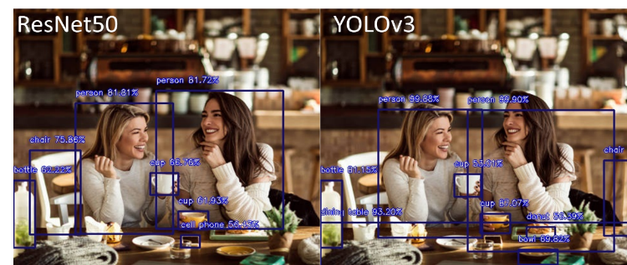
Comparison of Object Detection Techniques:
Figure 11: Figure showing the detection output of ResNet50 and YOLOv3 on a test
image (restaurant)

Slide 38
Conclusion:
From this experiment, the Background Subtraction technique for motion detection is only suitable for indoor applications as its performance is highly susceptible to noise due to changing environmental factors like light intensity, shadows, and wind.

Slide 39
Conclusion:
For the face detection aspect of the face recognition, Haarcascade detection was more time efficient but will be less suitable due to its poor detection accuracy on distorted or tilted faces. MTCNN proved to be a better face detection model as it is more robust to variations in facial orientations and distortions. For the classification part of the facial recognition, the neural network has high computational time but its ability to recognize faces from only one sample by creating a facial embedding of the face which highlights all the important facial features make it more applicable in Intelligent Video Surveillance because in real life situations, we may not have the luxury of getting multiple and varied pictures of a person to train the other models to properly identify the face of a person.

Slide 40
Conclusion:
Finally, for the object detection, YOLOv3 is a better network model than the ResNet50 model. Although it struggles in the detection of very small objects unlike ResNet50, it still has comparable overall detection accuracy, and its inference time is less than 50% of the inference time of ResNet50. This inference time difference between the two models is very vital at it means that the frame speed of the YOLOv3 is about 32.3fps while that of ResNet50 is merely 11.4fps which will be too slow if used to implement real time video surveillance.

Slide 41
THANK YOU!

